Slide 1

Expand course8-Dancer on the stage
Yahboom
Yahboom Omibox Tutorial

Slide 2
1
2
3
4
5
Search for
blocks
Combine
blocks
Experimental
phenomena
Preparation
Learning
goals
程序编程
Tencent
Yahboom Omibox Tutorial

Slide 3
1
Preparation-1
1. The position of the RGB lights, Buzzer, Motor in the robot car
2. Learn how to use RGB lights graphically program building blocks, Buzzer graphically program building blocks, Robot sport graphically program building blocks
Yahboom Omibox Tutorial

Slide 4
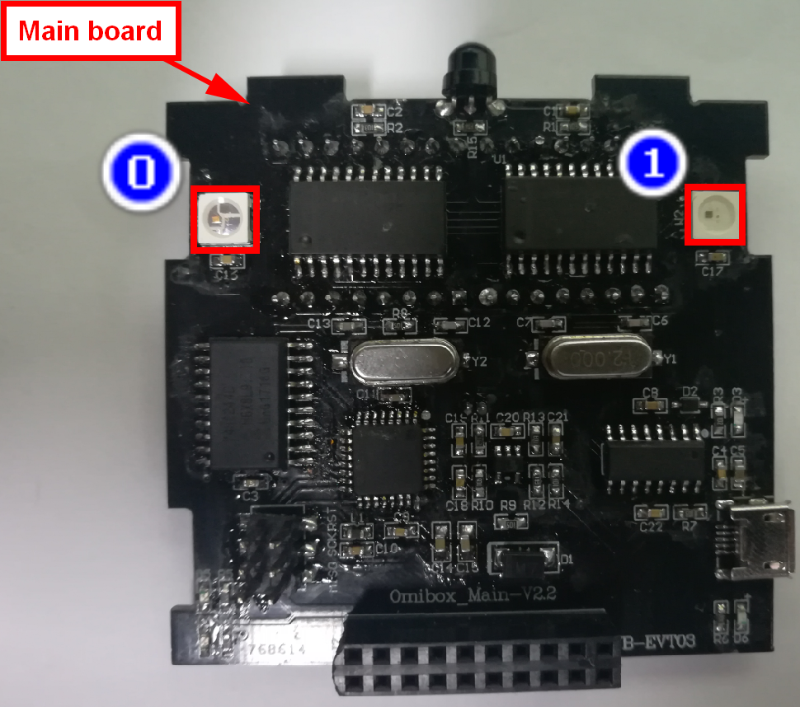
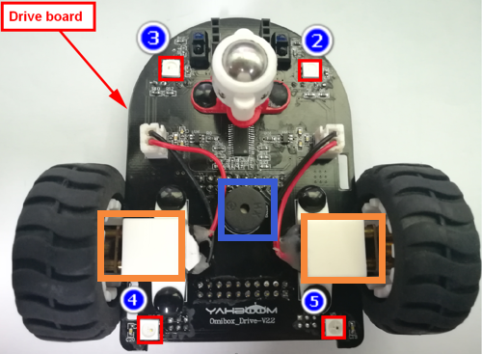
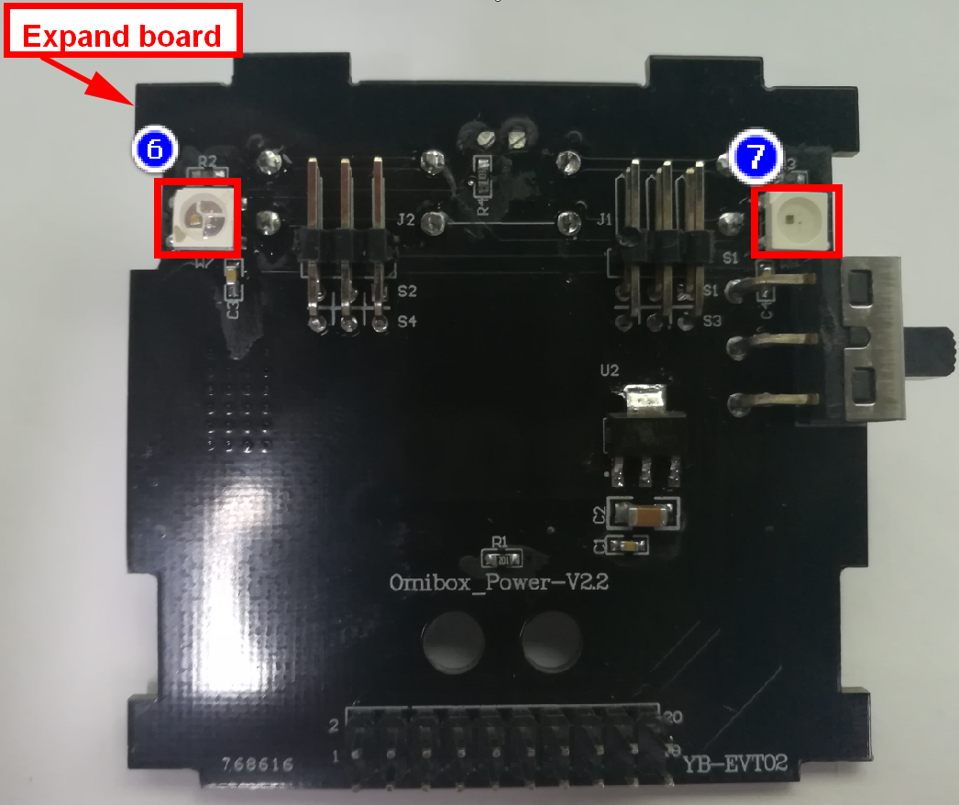
1
Preparation-2
As shown in the above picture, we circled the white square with a red wire frame. This white square is the RGB light on the Omibox. We circled the buzzer with a blue wire frame. We circled the motor with two orange wire frame. We can control them by programming.
Yahboom Omibox Tutorial

Slide 5
2
Learning goals
In this lesson, we learn how to make the Omibox programmable robot sing "Two Tigers" and complete the actions of forward, backward, turn left, turn right, etc., and the RGB lights emit different colors of light.
Yahboom Omibox Tutorial

Slide 6
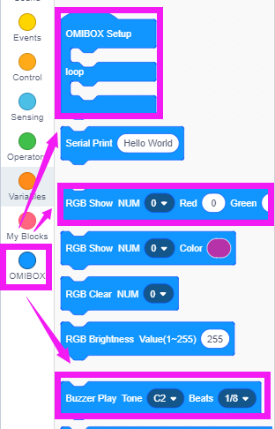
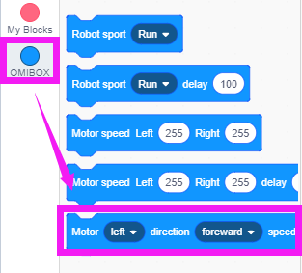
3
Search for blocks
The following is the location of the building blocks required for this programming.
Yahboom Omibox Tutorial

Slide 7
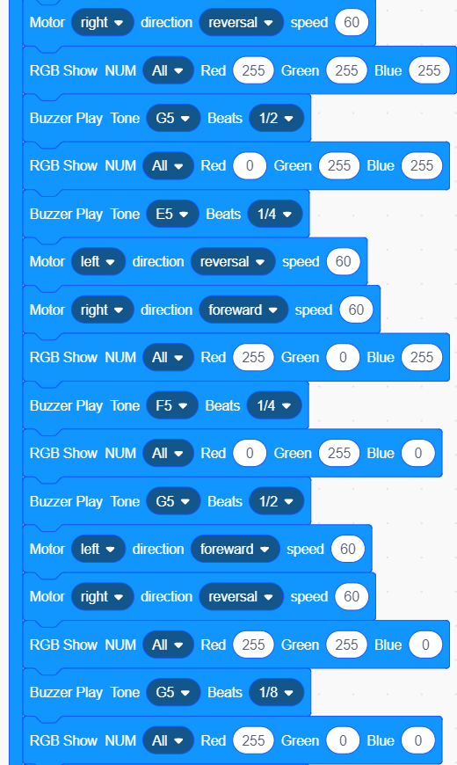
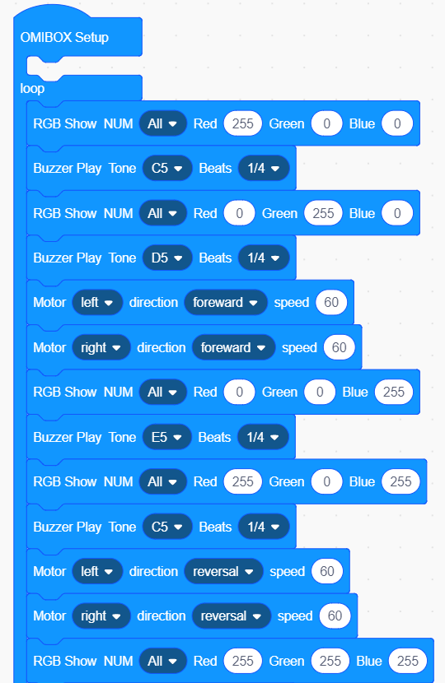
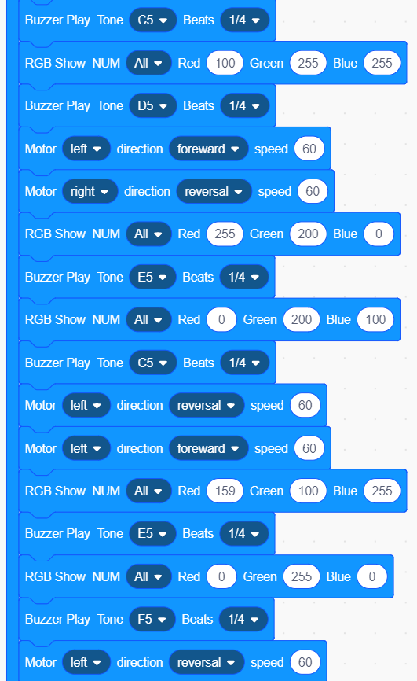
4
Combine blocks
The summary program is shown below:
Yahboom Omibox Tutorial

Slide 8
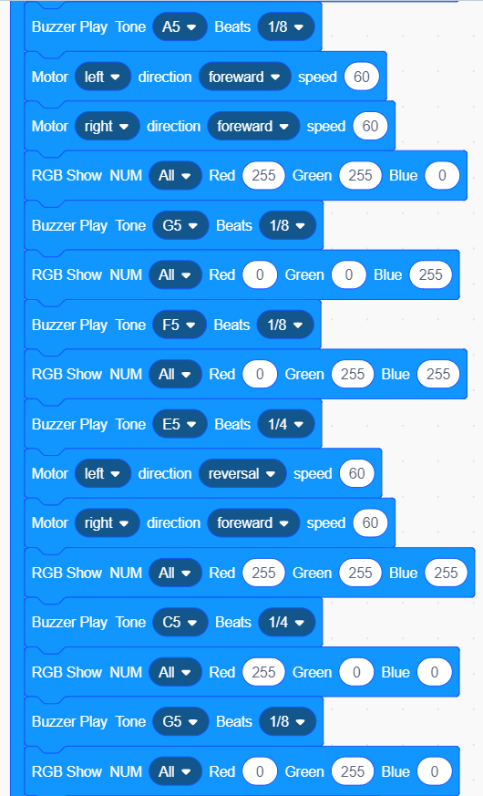
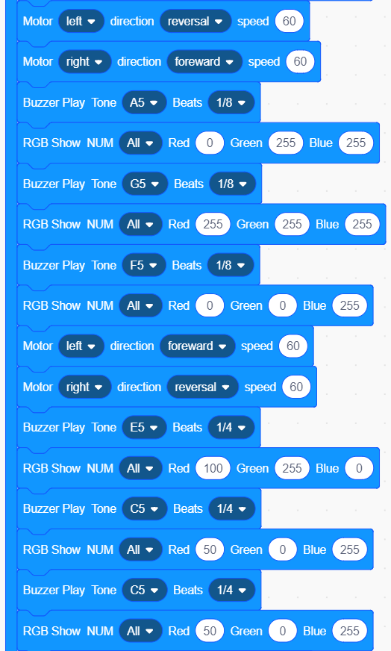
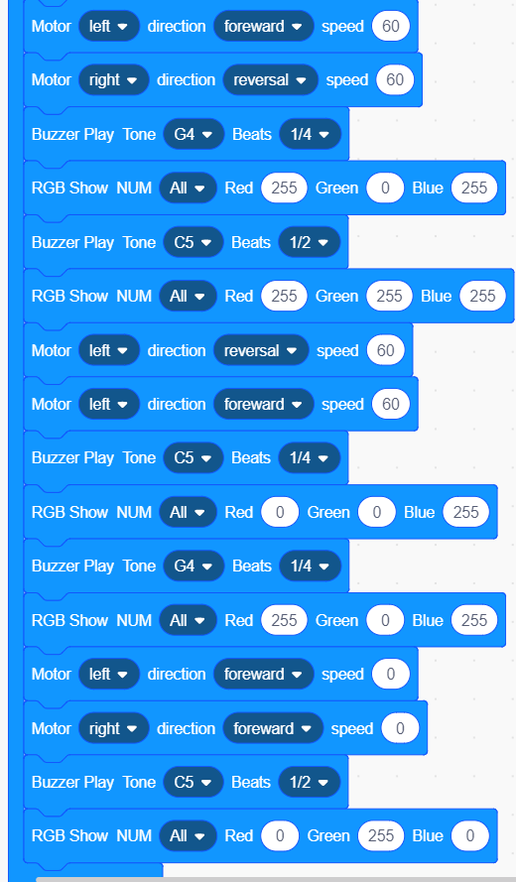
4
Combine blocks
Yahboom Omibox Tutorial

Slide 9
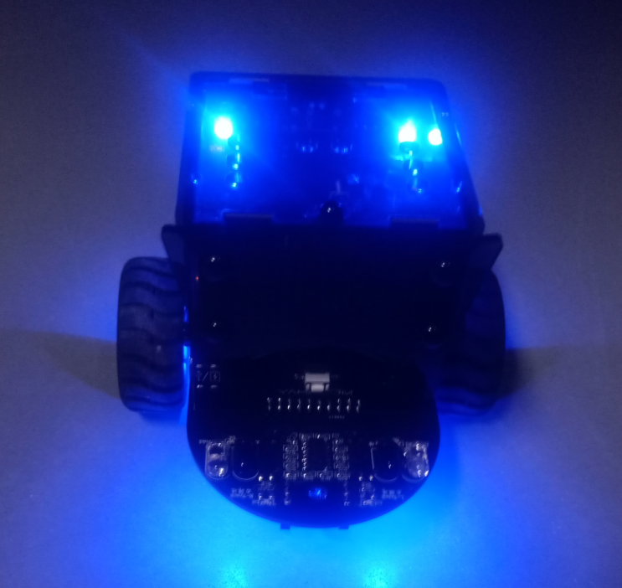
5
Experimental phenomena
After the program is uploaded, open the power of the robot. We can see that the Omibox robot car lights up the RGB lights of different colors, at the same time plays the song “Two Tigers”, and completes the movements of forward, backward, turn left and turn right.
Yahboom Omibox Tutorial

